Slide 1
Bootstrap and Qlik Sense
Kevin McGovern, Slalom
Qonnections 2016

Slide 2





Kevin McGovern
Four years using QlikView
Early adopter of Qlik Sense
Experience building mashups and extensions
Contributor to Qlik Branch
Consultant with Slalom for 1 ½ years
mcgovey
@mcgovey
Slalom Consulting
kmcgovern1

Slide 3
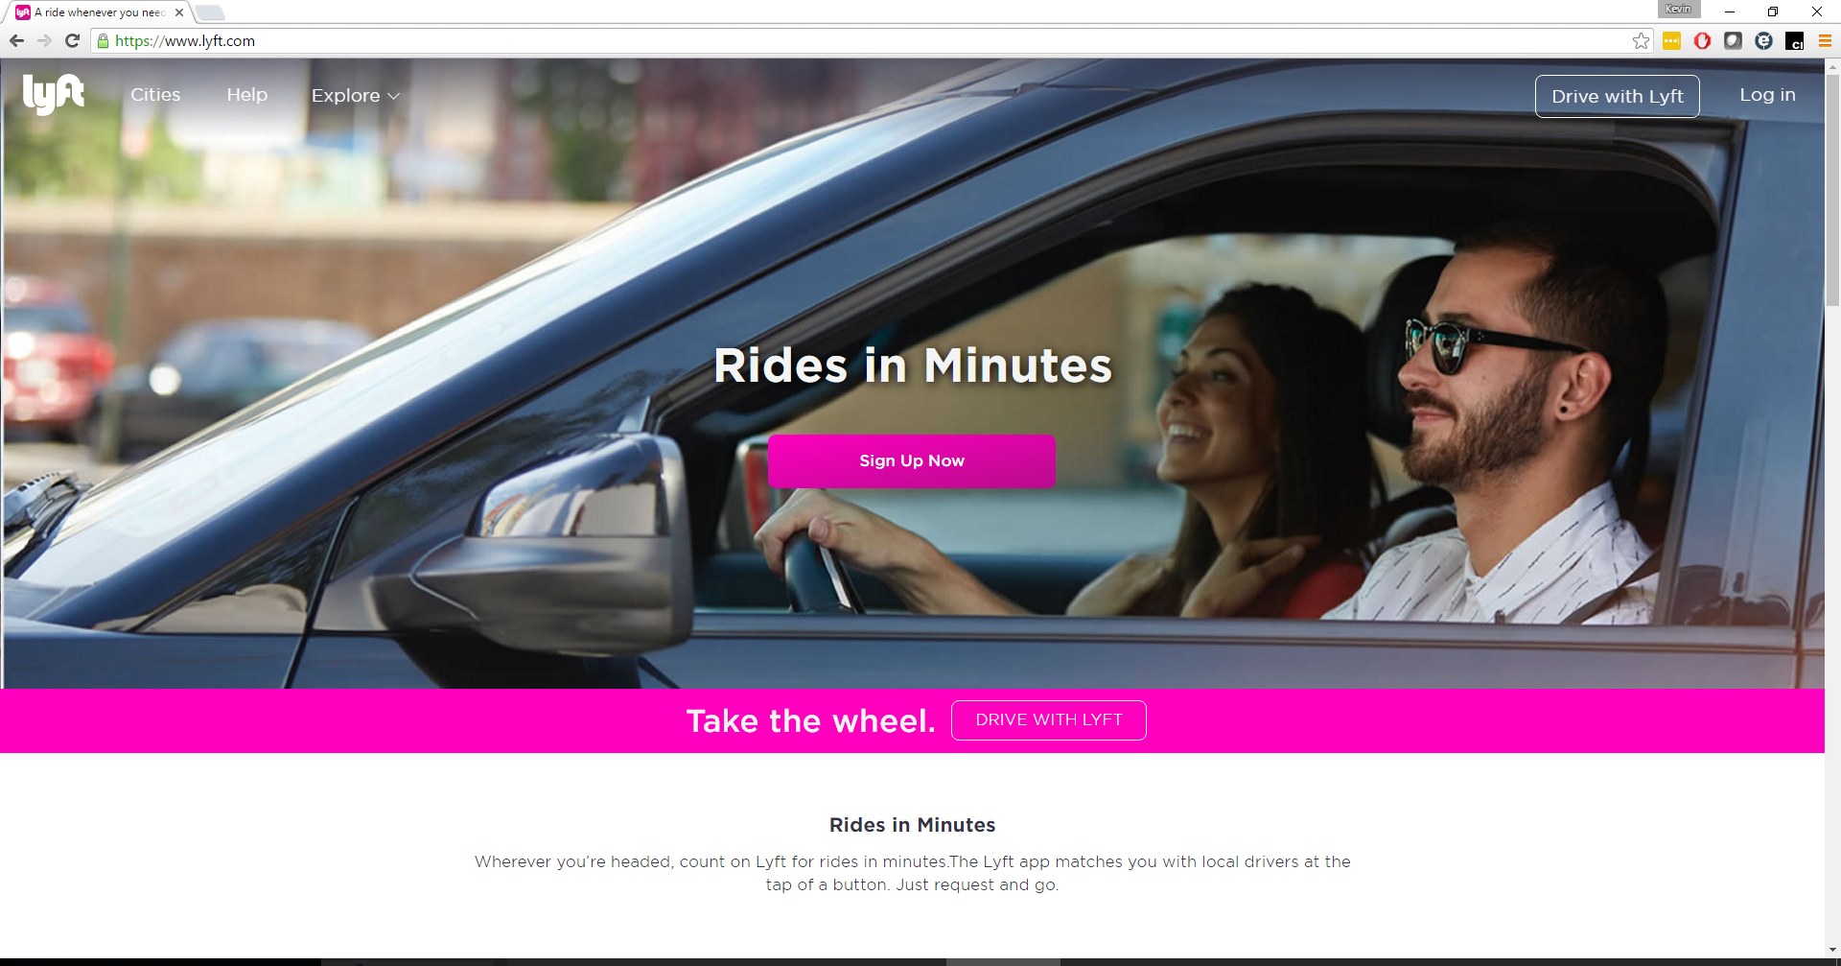
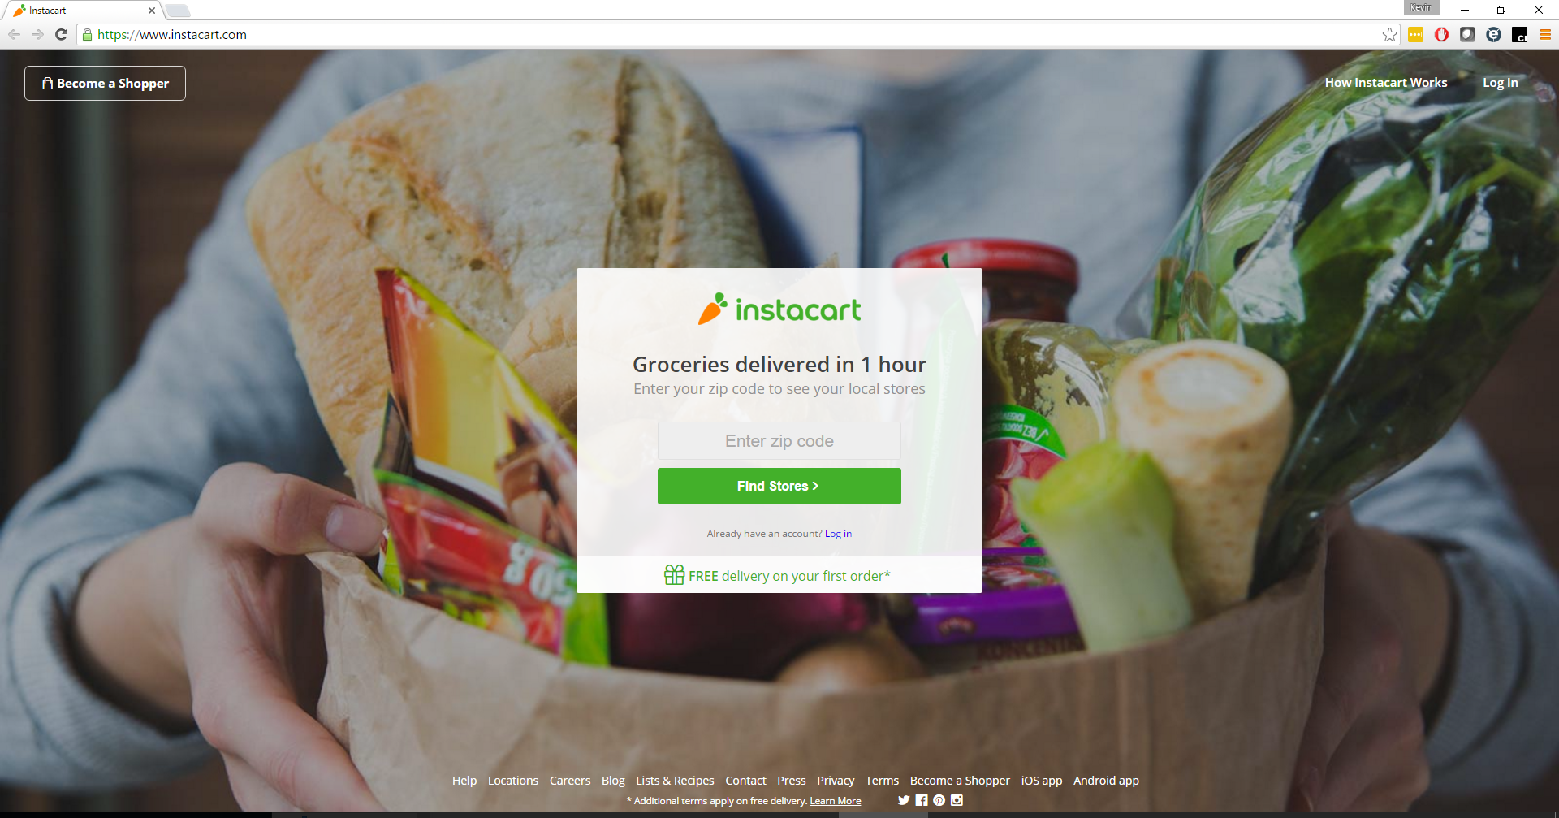
Where is Bootstrap used?

Slide 4
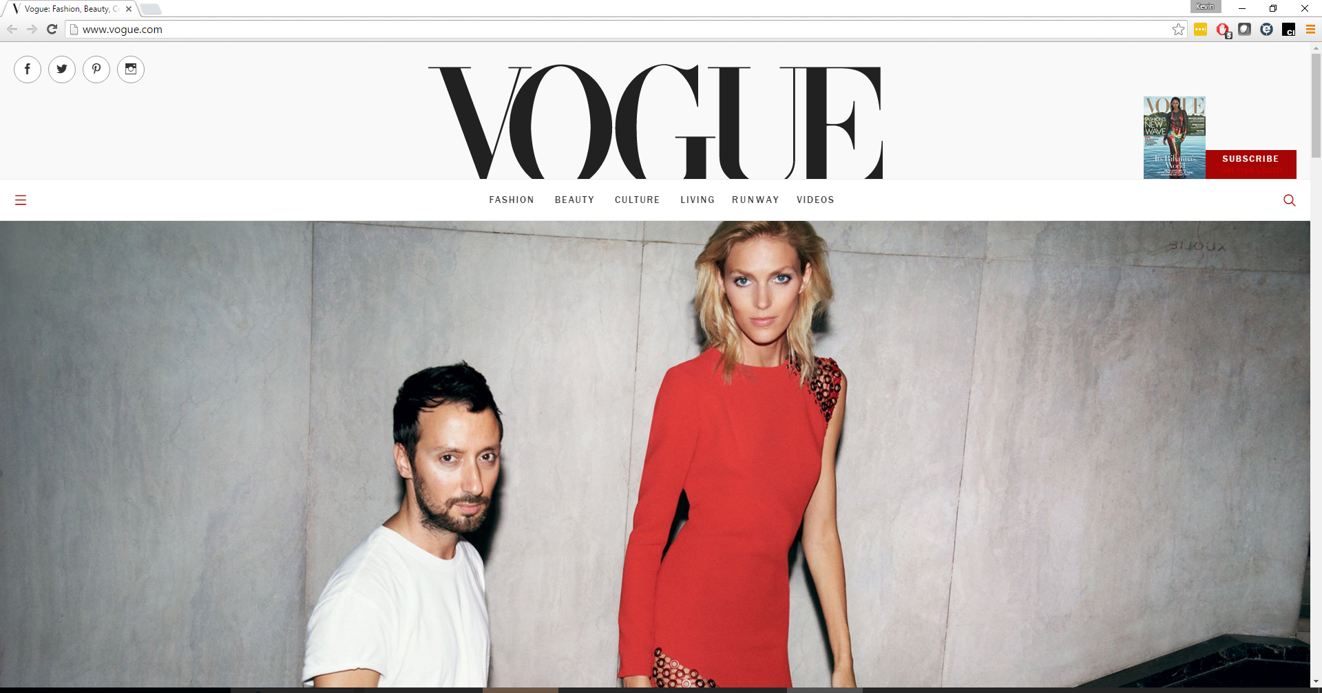
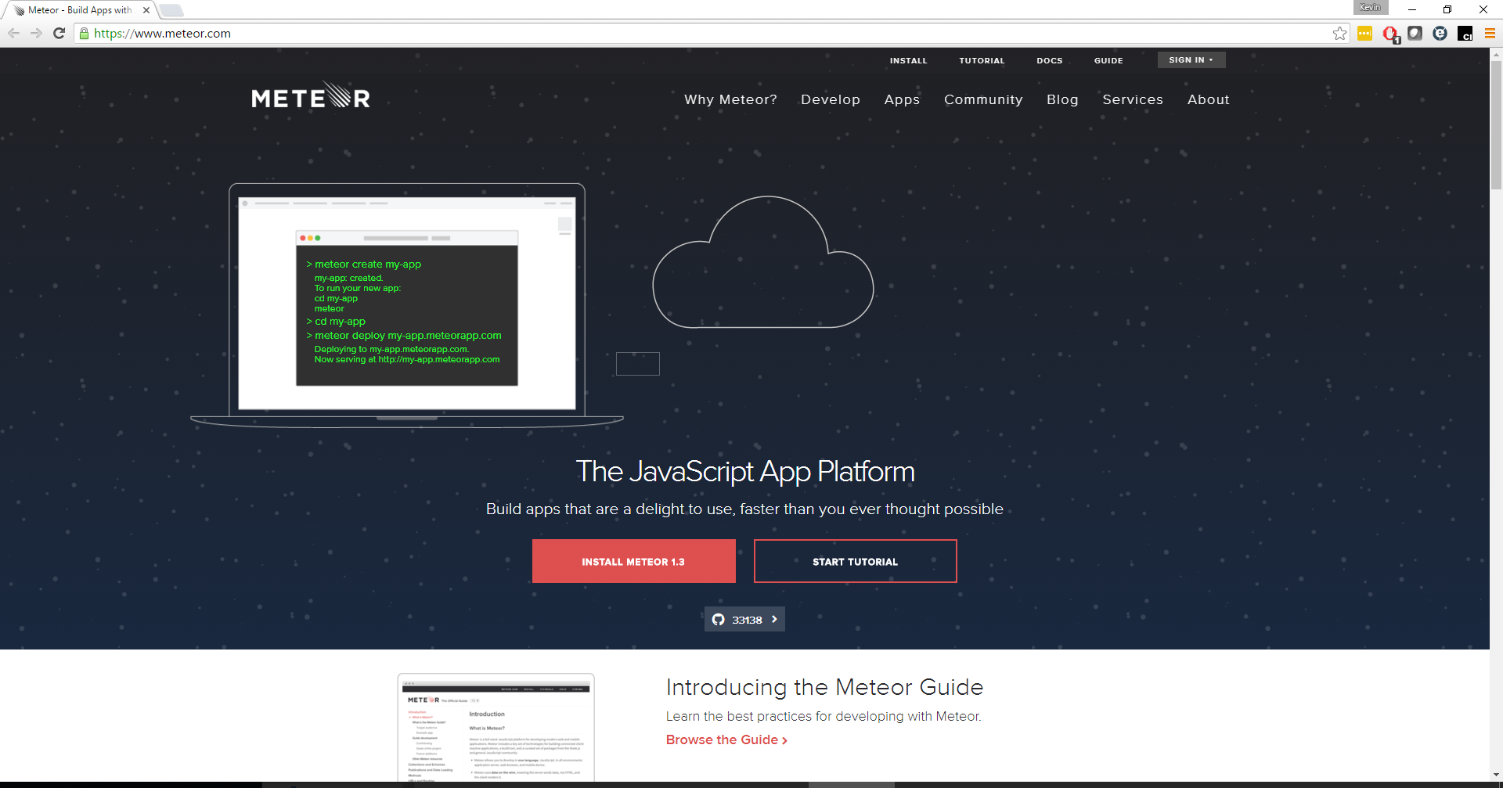

Slide 5
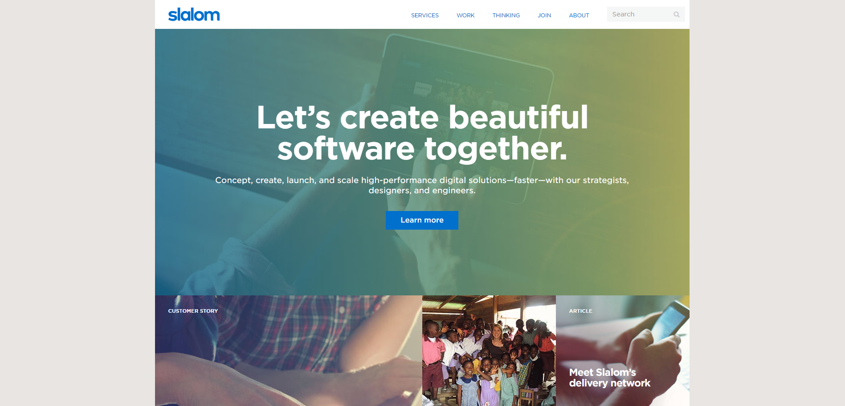

Slide 6

What is Bootstrap?
Developed at Twitter in 2010
Initially called Blueprint
Style guide for internal sites
v2 responsive
v3 mobile-first
v4 coming out soon
http://getbootstrap.com/

Slide 7
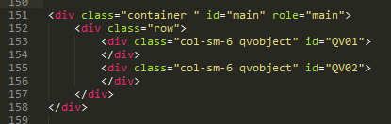
How does Bootstrap work?
CSS (Cascading Style Sheet)
For each HTML element, assign
specific class that is defined in Bootstrap
JavaScript
Prebuilt helper functions
Themes
Change standard Bootstrap styling

Slide 8
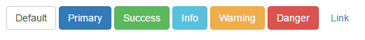
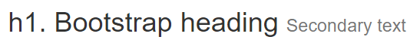
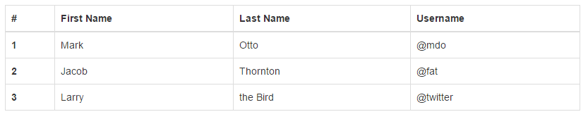
Common Bootstrap Elements
Grid
Navbar
Buttons
Typography
Tables
Modal
Alerts

Slide 9
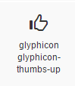
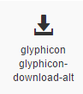
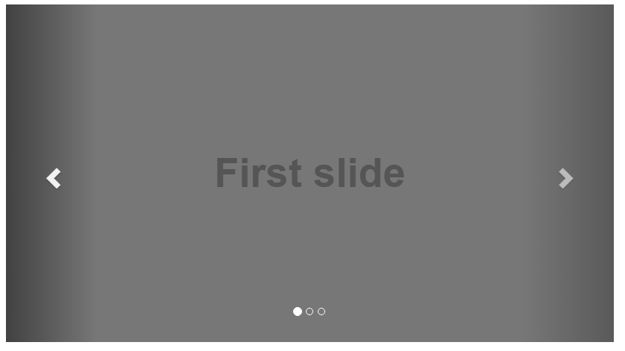
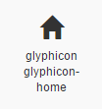
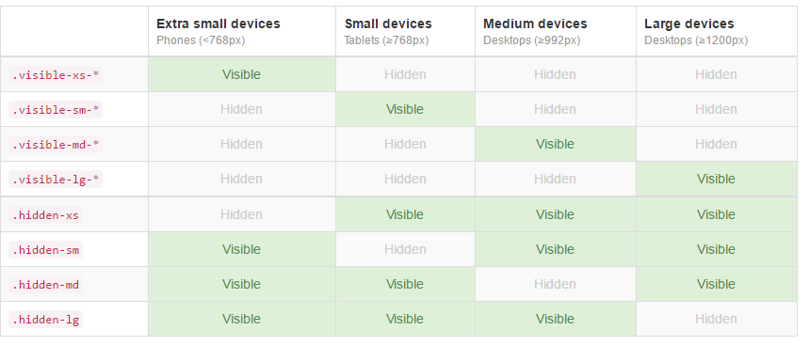
Common Bootstrap Elements (continued)
Carousel
Scrollspy
Tooltip
Icons
Display based on screen size

Slide 10
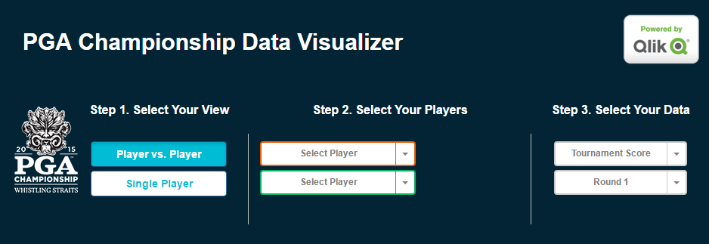
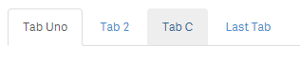
What does this have to do with Qlik Sense?
Mashups
Speed up time to build
Responsive
Included in most templates
Extensions
Add some style to your extensions

Slide 11
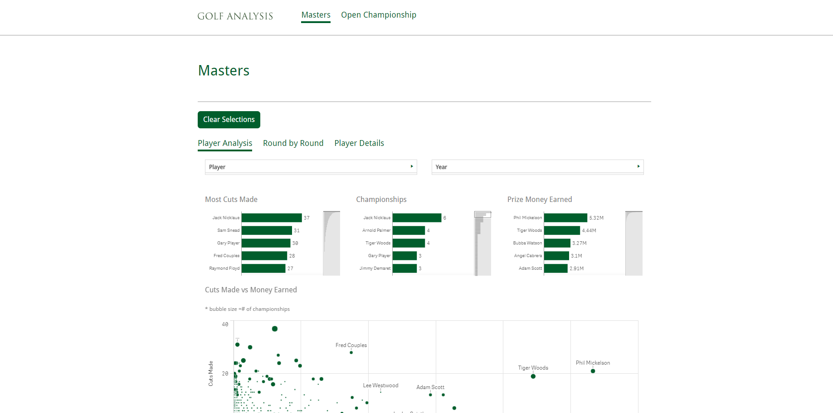
Qlik Bootstrap Mashup Example

Slide 12
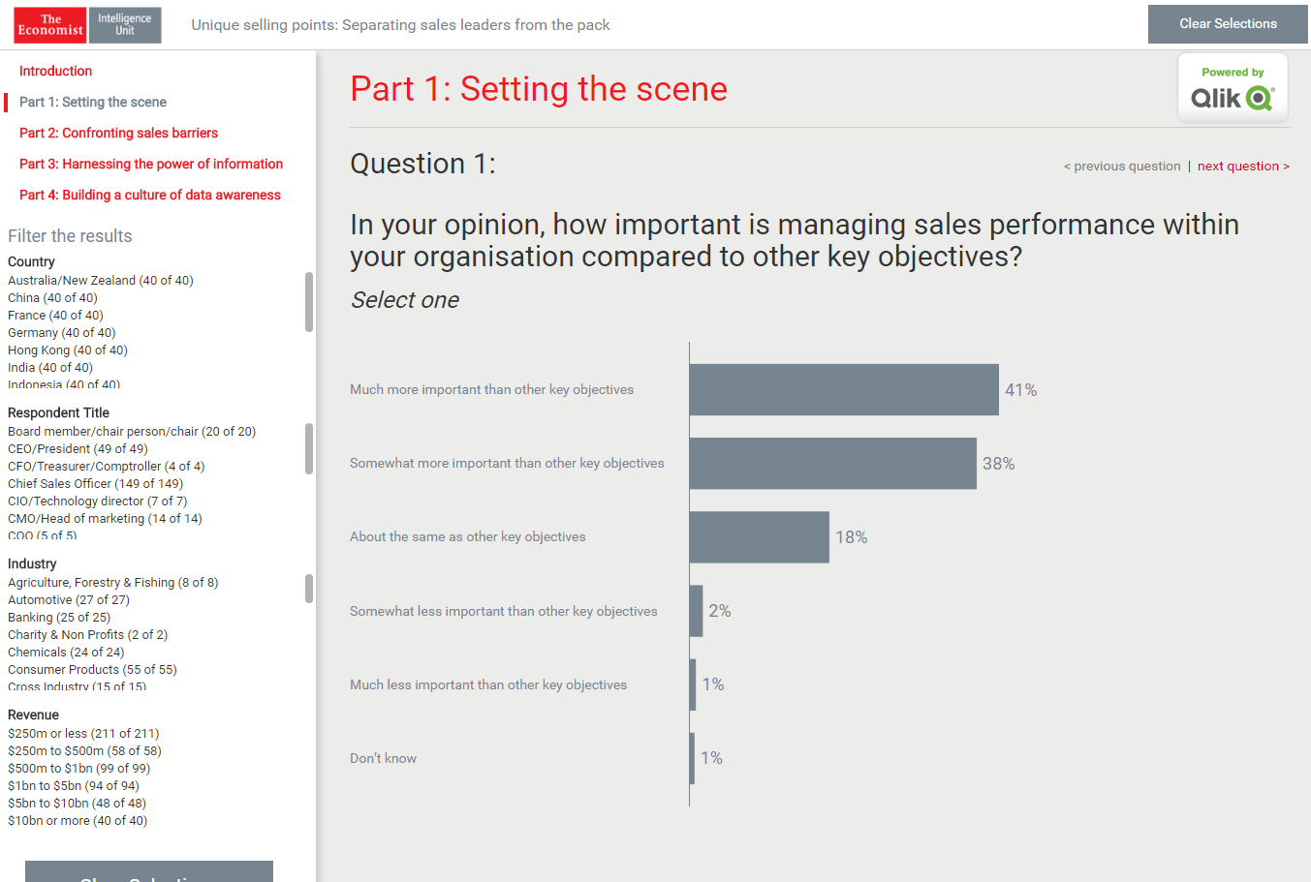
Qlik Bootstrap Mashup Example

Slide 13

Considerations before using Bootstrap
Not best for heavy transaction sites
Sites with a design framework in place
Class collision

Slide 14
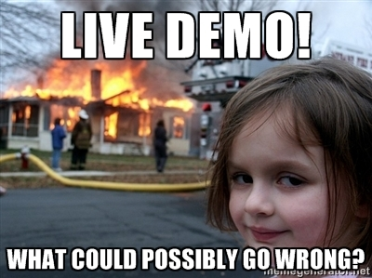

Slide 15
Outline of demo
Mashup
Show final product
Create new mashup
Use mashup without CDNs
Navbar
Grid
Resize
Typography
Button
Modal
Extension
Show final product
Create new extension – break it
Update CSS fixed
Add BS button

Slide 16
Summarize Bootstrap and Qlik Sense
Framework for building quick, clean webpages
Used throughout the web
Well documented
Can help build quick Qlik Sense mashups and extensions
Included with most mashup templates
Needs some work before it can be used in an extension

Slide 17
Resources
mcgovey
Presentation GitHub: Qonnections16-QS-Bootstrap
Bootstrap References:
Bootstrap Download
Cheat Sheet
Tutorials
Themes
Scoping Bootstrap
Stefan Walter’s Blog Post
Stefan Walter’s Qlik Sense Tutorial
Namespaced-Bootstrap

Slide 18
Questions?
Where can I find these slides and examples?
https://git.io/vw481

